Slide 1

Object-Oriented Programming using C++ - Day3

Slide 2
Recap of Day 2
Dynamic Memory Allocation
Inline Functions
Static Members
Const Members
Polymorphism
‘this’ pointer
Aggregation
Cin & Cout

Slide 3
Session plan – Day 3
Inheritance
Method Overriding
Base class pointers pointing to Derived class
Virtual Functions and Dynamic Binding
Abstract classes
Different types of Inheritance

Slide 4
Inheritance
The process of deriving a new class from an existing class is called as Inheritance
The existing class is referred to as the base class or super class and the new class is called the derived class or subclass.
Through Inheritance, C++ strongly supports the idea of Reusability. That is making use of the existing features to create the new feature.
All the objects in this world come under some kind of classification. Inheritance allows the creation of hierarchical classification.
For example, the bike “Yamaha” is a kind of ‘Two Wheeler’ which is again a kind of ‘Vehicle’.
Notes:
Inheritance is the mechanism which allows a class A to inherit properties of a class B. We say ``A inherits from B''. Objects of class A thus have access to attributes and methods of class B without the need to redefine them.
Inheritance also promotes reuse. You don't have to start from scratch when you write a new program. You can simply reuse an existing repertoire of classes that have behaviors similar to what you need in the new program.
Base class is also called Super Class and Derived class is called Child class.
By using the concept of inheritance, it is possible to create a new class from an existing one and add new features to it. Thus inheritance provides a mechanism for class level reusability.
The principle behind this sort of division is that each derived class shares common characteristics with the class from which it is derived. Once the base class ‘Vehicle’ is defined with all general attributes, there is no need to redefine it once again in the derived classes.

Slide 5
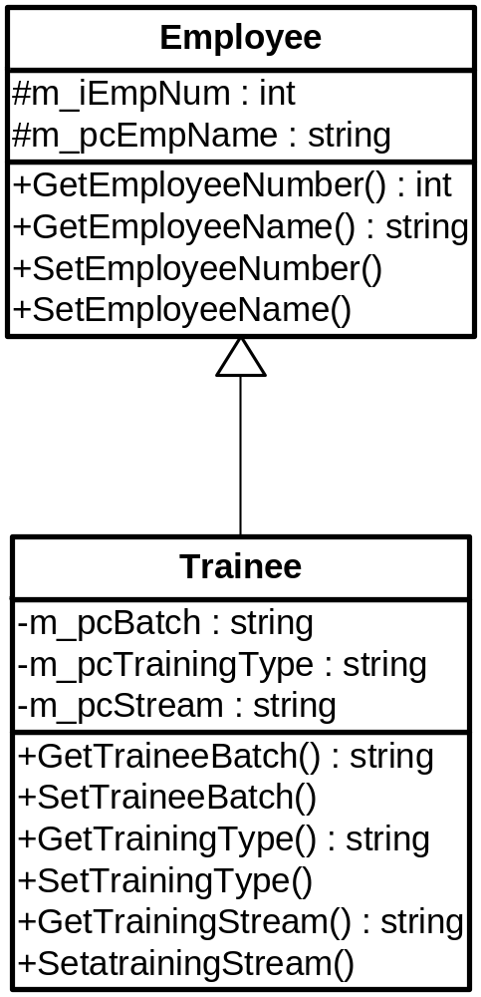
Inheritance – Generalization & Specialization
Base Class
Generalization and Specialization are associated with the concept of Inheritance
The Trainee class derives the Employee class
Employee class is a generalization of Trainee class
Trainee class is a specialization of the Employee class
The relationship between Derived class and Base class is ‘Is-A’
Derived Class

Slide 6
Inheritance – Creating derived classes
The general format of deriving the properties from one class to another class is :
class <derived-class-name> : [visibility-mode] <base-classname>
// members of derived class
};
Here, the visibility mode is optional and , if present, may be either private or public or protected.
The default visibility mode is private.
Visibility mode specifies whether the features of the base class are privately derived or publicly derived.

Slide 7
Inheritance - Example
class Employee {
private:
int m_iEmpId;
float m_fBasic;
float m_fSal;
public:
void CalculateSal() {
m_fSal=m_fBasic+.4*m_fBasic;
}
};
Class Trainee : public Employee {
private:
float m_fTPI;
public:
void CalculateTPI(char cGrade) {
if(cGrade==‘A’) {
m_fTPI=1200;
}else {
m_fTPI=900;
}
}
}
Employee oE1;
Trainee oT1;
oE1.CalculateTPI();//Invalid
oE1.CalculateSal(); //Valid
oT1.CalculateSal(); //Valid
oT1.CalculateTPI(); //Valid

Slide 8
Inheritance – Memory allocation for objects
class Employee {
private:
int m_iEmpId;
float m_fBasic;
float m_fSal;
public:
void CalculateSal() {
m_fSal=m_fBasic+.4*m_fBasic;
}
};
Employee oE1;
m_iEmpId
m_fBasic
M_fSal
Class Trainee : public Employee {
private:
float m_fTPI;
public:
void CalculateTPI(char cGrade) {
//Code to calculate TPI
}
};
Trainee oT1;
m_iEmpId
m_fBasic
m_fSal
m_fTPI

Slide 9
Inheritance – Protected Members
The ‘private’ members cannot be accessed outside the scope of the class.
The derived class also cannot access the private members.
Sometimes, we want the derived class to access the private members of the base class but at the same time, we don’t want other classes or functions to access those members thru the objects.
Those members come under protected access specifier.
In other words, protected members are private to all, but public to its derived classes.

Slide 10
Inheritance – Protected Members – Example
Valid
class Employee {
private:
int m_iEmpId;
protected:
float m_fBasic;
float m_fSal;
public:
void CalculateSal() {
m_fSal=m_fBasic+.4*m_fBasic;
}
};
Class Trainee : public Employee {
private:
float m_fTPI;
public:
void CalculateTPI(char cGrade) {
if(cGrade==‘A’) {
m_fTPI=1200;
}else {
m_fTPI=900; }
m_fSal=m_fBasic+m_fTPI;
printf(“%d%f”,m_iEmpID,m_fSal);
}
}
Invalid
Trainee oT1;
Employee oE1;
oE1.m_fBaisic // Invalid

Slide 11
Inheritance – Protected Members (Continued)
Advantages:
  Derived classes can modify values of members of base directly
  Slight increase in performance; Avoids set/get function call overhead
Disadvantages:
  No validity checking
    Derived class can assign illegal values
  Implementation dependent
    Derived class member functions more likely dependent on base class implementation
    Base class implementation changes may result in derived class modifications resulting in Fragile (brittle) software

Slide 12
Inheritance – Types of Inheritance
In C++, Inheritance can be classified based on two aspects namely,
    Based on access Specifiers while deriving the classes
      public Inheritance
      protected Inheritance
      private Inheritance
    Based on structure of classes in Inheritance
      Single Inheritance or Simple Inheritance
      Multiple Inheritance ( very rarely used)
      Multilevel Inheritance
      Hierarchical Inheritance
      Hybrid Inheritance ( very rarely used)

Slide 13
Inheritance – Public Inheritance
class MyDerived : public MyBase {
//Class MyDerived will inherit protected and public members of MyBase
//with no change in access specifier
}
MyBase
Public Members
Protected Members
Private members
MyDerived
Public Members
Protected Members
Inherited – not accessible

Slide 14
Inheritance – Protected Inheritance
class MyDerived : protected MyBase {
//Class MyDerived will inherit protected and public members of MyBase
//with public members getting promoted to protected members
}
MyBase
Public Members
Protected Members
Private members
MyDerived
Protected Members
Protected Members
Inherited – not accessible

Slide 15
Inheritance – Private Inheritance
class MyDerived : private MyBase {
//Class MyDerived will inherit protected and public members of MyBase
//with protected and public members getting promoted to private
}
MyBase
Public Members
Protected Members
Private members
MyDerived
Private Members
Private Members
Inherited – not accessible

Slide 16
Inheritance - Summary
Type of Inheritance | Accessible inside Derived Class? i.e. In any of the methods of derived class |  |  | Accessible outside Derived Class? i.e. through derived class objects
 | Private member of Base class | Protected member of Base Class | Public member of Base class | Private member of Base class | Protected member of Base class | Public member of Base class
Private | NO | YES | YES | NO | NO | NO
Protected | NO | YES | YES | NO | NO | NO
Public | NO | YES | YES | NO | NO | YES

Slide 17
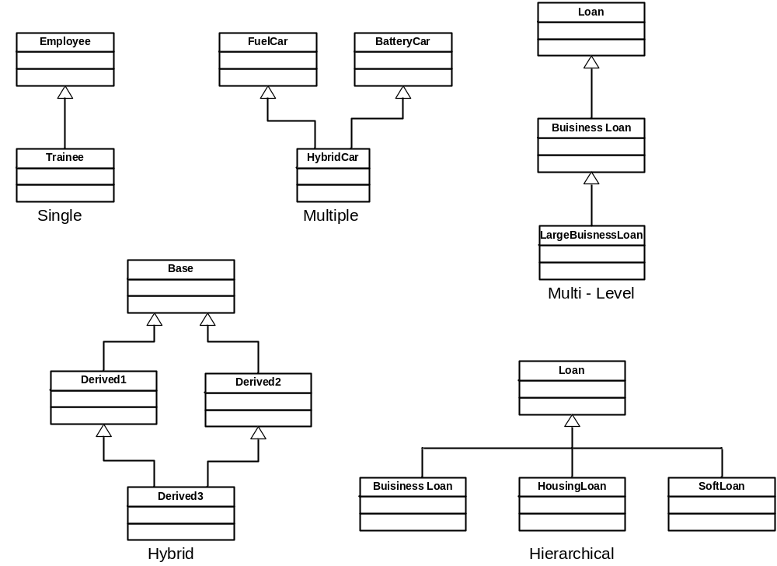
Inheritance Types – Based on structure

Slide 18
Inheritance – Constructors & Destructors
Constructors & Destructors are not inherited whatever may be the access specifier used.
When you create object of Derived, Base class default constructor is executed first and then derived class constructor is executed
If you want to execute a specific Base class constructor during derived class object creation, you can specify that in derived class constructor header.
In case of multiple inheritance base class constructor is executed in the order they appear in derived class declaration.
In case of multilevel inheritance, constructors are executed in the order of inheritance.
When the object of derived is destroyed, destructor of derived is executed first and then the base class destructor is executed.

Slide 19
Inheritance – Constructors & Destructor
General syntax for calling base class constructor from derived class
<Derived class Constructor >:<Base Class Constructor>(parameters) { ……}
class Employee {
private: int m_iEmpId; float m_fBasic, m_fSal;
public:
Employee(int iEmp,float fBasic) {
// Base Constructor
}
};
Class Trainee : public Employee {
private:
float m_fTPI;
public:
Trainee(int iEmp,float fBasic,float fTPI) : Employee(iEmp,fBasic) {
// Derived Constructor
}
};

Slide 20
Method Overriding
Redefining the methods in the derived class which is already defined in the base class is called method overriding.
When this method is invoked by derived class object, the method defined in the derived class gets executed.
class Employee {
protected:
int m_iEmpId;
float m_fSal,
float m_fHRA;
public:
void CalcSal() {
m_fSal=m_fHRA+120;
}
};
class Trainee :public Employee {
private:
float m_fTPI;
public:
void CalcSal() {
m_fSal=m_fHRA+m_fTPI;
}
};
Employee oE1;
Trainee oT1;
oE1.CalcSal()
oT1.CalcSal();

Slide 21
Base class pointer & Derived class objects
class Employee {
protected:
int m_iEmpId;
float m_fSal,m_fHRA;
public:
void CalcSal() {
m_fSal=m_fHRA+120;
}
}
class Trainee :public Employee {
private:
float m_fTPI;
public:
void CalcSal() {
m_fSal=m_fHRA+m_fTPI;
}
}
Employee* poE1;
poE1= new Employee();
poE1->CalcSal();
Employee* poE1;
poE1= new Trainee();
poE1->CalcSal();
/*base class pointer type casted*/
(Trainee*)poE1->CalcSal();

Slide 22
Virtual Functions – Dynamic Polymorphism
It is also possible to make a base class pointer to invoke a method in the derived class without type casting
This is done using the concept of virtual functions.
The following declares a virtual function:
virtual void CalcSal();
Employee * poE1 = new Trainee();
poE1->CalcSal();
This invokes the Trainee::CalcSal() using base class pointer.
Here binding function call with the function definition happens during program execution. This is called as Dynamic Binding.
Notes:
By creating virtual functions in the base class, the derived class member functions can be accessed through the base class pointers. The decision to invoke the base class or the derived class member functions is done at run time (dynamically). This leads to dynamic binding.
When we used type casting to be able to point to the derived class, the binding was statically determined.

Slide 23
Virtual Functions – Dynamic Polymorphism – Example
class Employee {
protected:
int m_iEmpId;
float m_fSal;
float m_fHRA;
public:
virtual void CalcSal() {
m_fSal=m_fHRA+120;
}
};
class Trainee :public Employee {
private:
float m_fTPI;
public:
void CalcSal() {
m_fSal=m_fHRA+m_fTPI;
}
};
Employee* poE1;
poE1= new Employee();
poE1->CalcSal();
Employee* poE1;
poE1= new Trainee();
poE1->CalcSal();

Slide 24
Inheritance – Abstract Class
Pure Virtual Functions
A pure virtual function is a virtual function that has no definition within the base class.
If a class contains at least one pure virtual function, that class is called as abstract class.
The derived class should implement the pure virtual function. If not, derived class also will be an abstract class.
Abstract class CANNOT BE instantiated. i.e. object of abstract class cannot be created.
The only purpose of abstract class is Generalization. i.e. It declares the prototype of collection of similar classes in the hierarchy of classes (Standard interface).
A general form of declaring pure virtual function is :
virtual <return-type> <func-name> ( [parameter-list ] ) = 0;
Pointer to an abstract class can be declared
Notes:
In C++, if one class contains at least one pure virtual function( a virtual function is a function whose function body is equated to 0) it is called as abstract class.
Let us look at the body of the two methods defined above. We cannot initialize the variables called speed and color unless until it is not a specialized class and they are declared as virtual as well as equated to 0.
When you say virtual somefunc(..) = 0;, you're telling the compiler that make the derived class implement this method and provide a sensible behavior. Once you declare a function as pure, you can't create an instance of the class.
Examples of Abstract classes: Shape, Vehicle, Fruit, Department.. etc

Slide 25
Abstract Class – Example
class Employee {
protected:
int m_iEmpId;
float m_fSal;
float m_fHRA;
public:
virtual void CalcSal() =0;
};
class Trainee :public Employee {
private:
float m_fTPI;
public:
void CalcSal() {
m_fSal=m_fHRA+m_fTPI;
}
};
Employee oE1; // Invalid
Employee* poE1; //Valid
poE1= new Employee();// Invalid
Employee* poE1;
poE1= new Trainee(); //Valid
poE1->CalcSal(); //Valid

Slide 26
Summary
Method Overriding
Pointer to objects
Base class pointers pointing to Derived class
Virtual Functions and Dynamic Binding
Abstract classes
Different types of Inheritance
Notes:
How to debug a program for logical errors
Refer to GDB slides for SC
For LC it is already covered in C programming.

Slide 27

Thank You!

